Slide 1
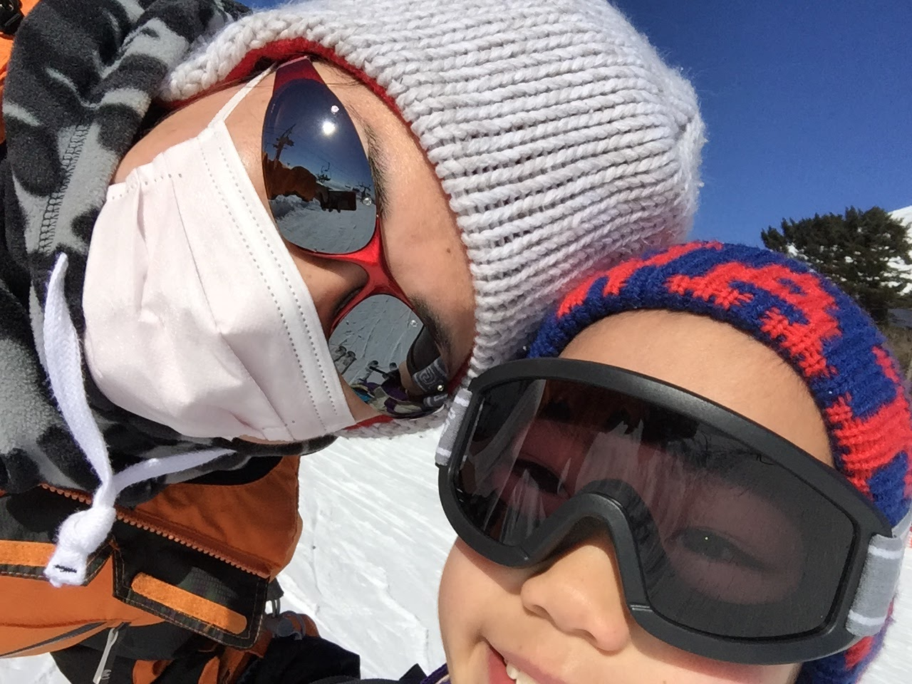
Self Introduction

Slide 2
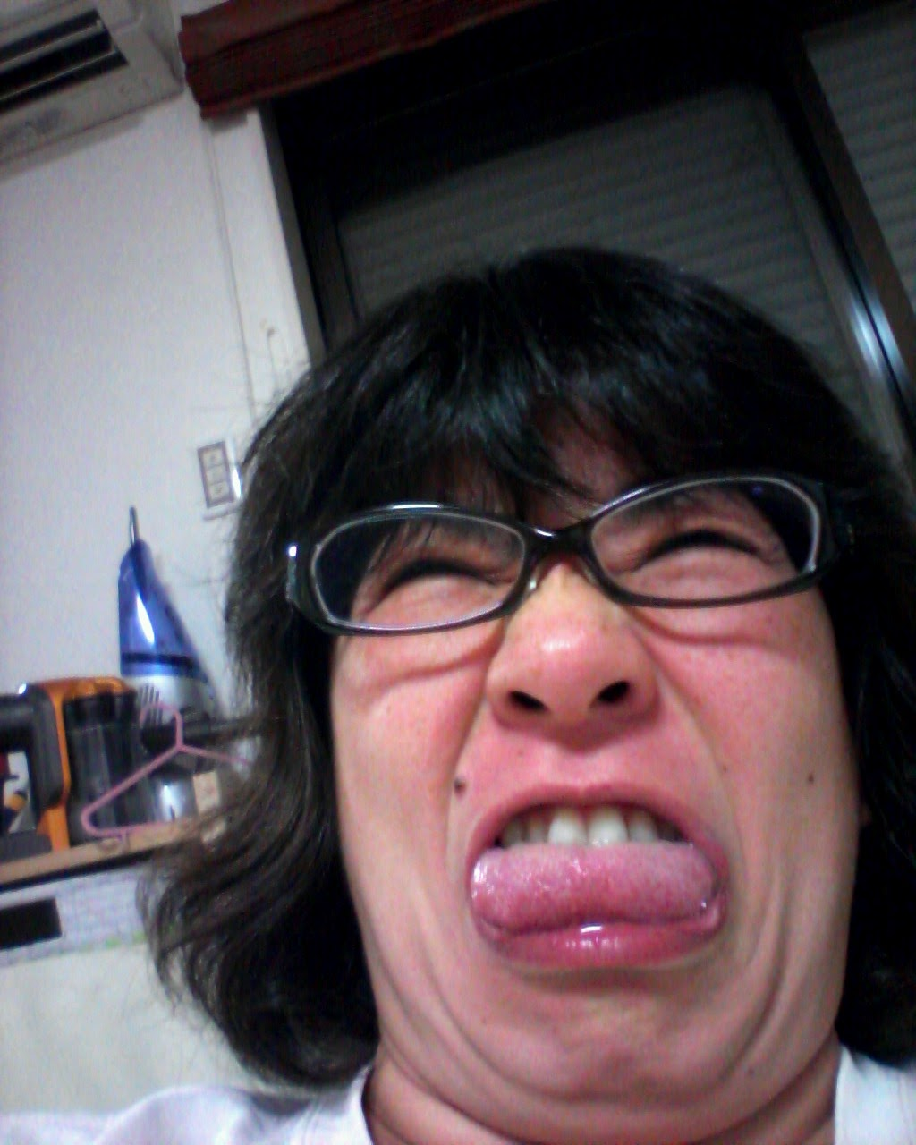
Hello!
I AM
KAMEKO OHMURA
I’m a software engineer of web services.
@okusama27

Slide 3
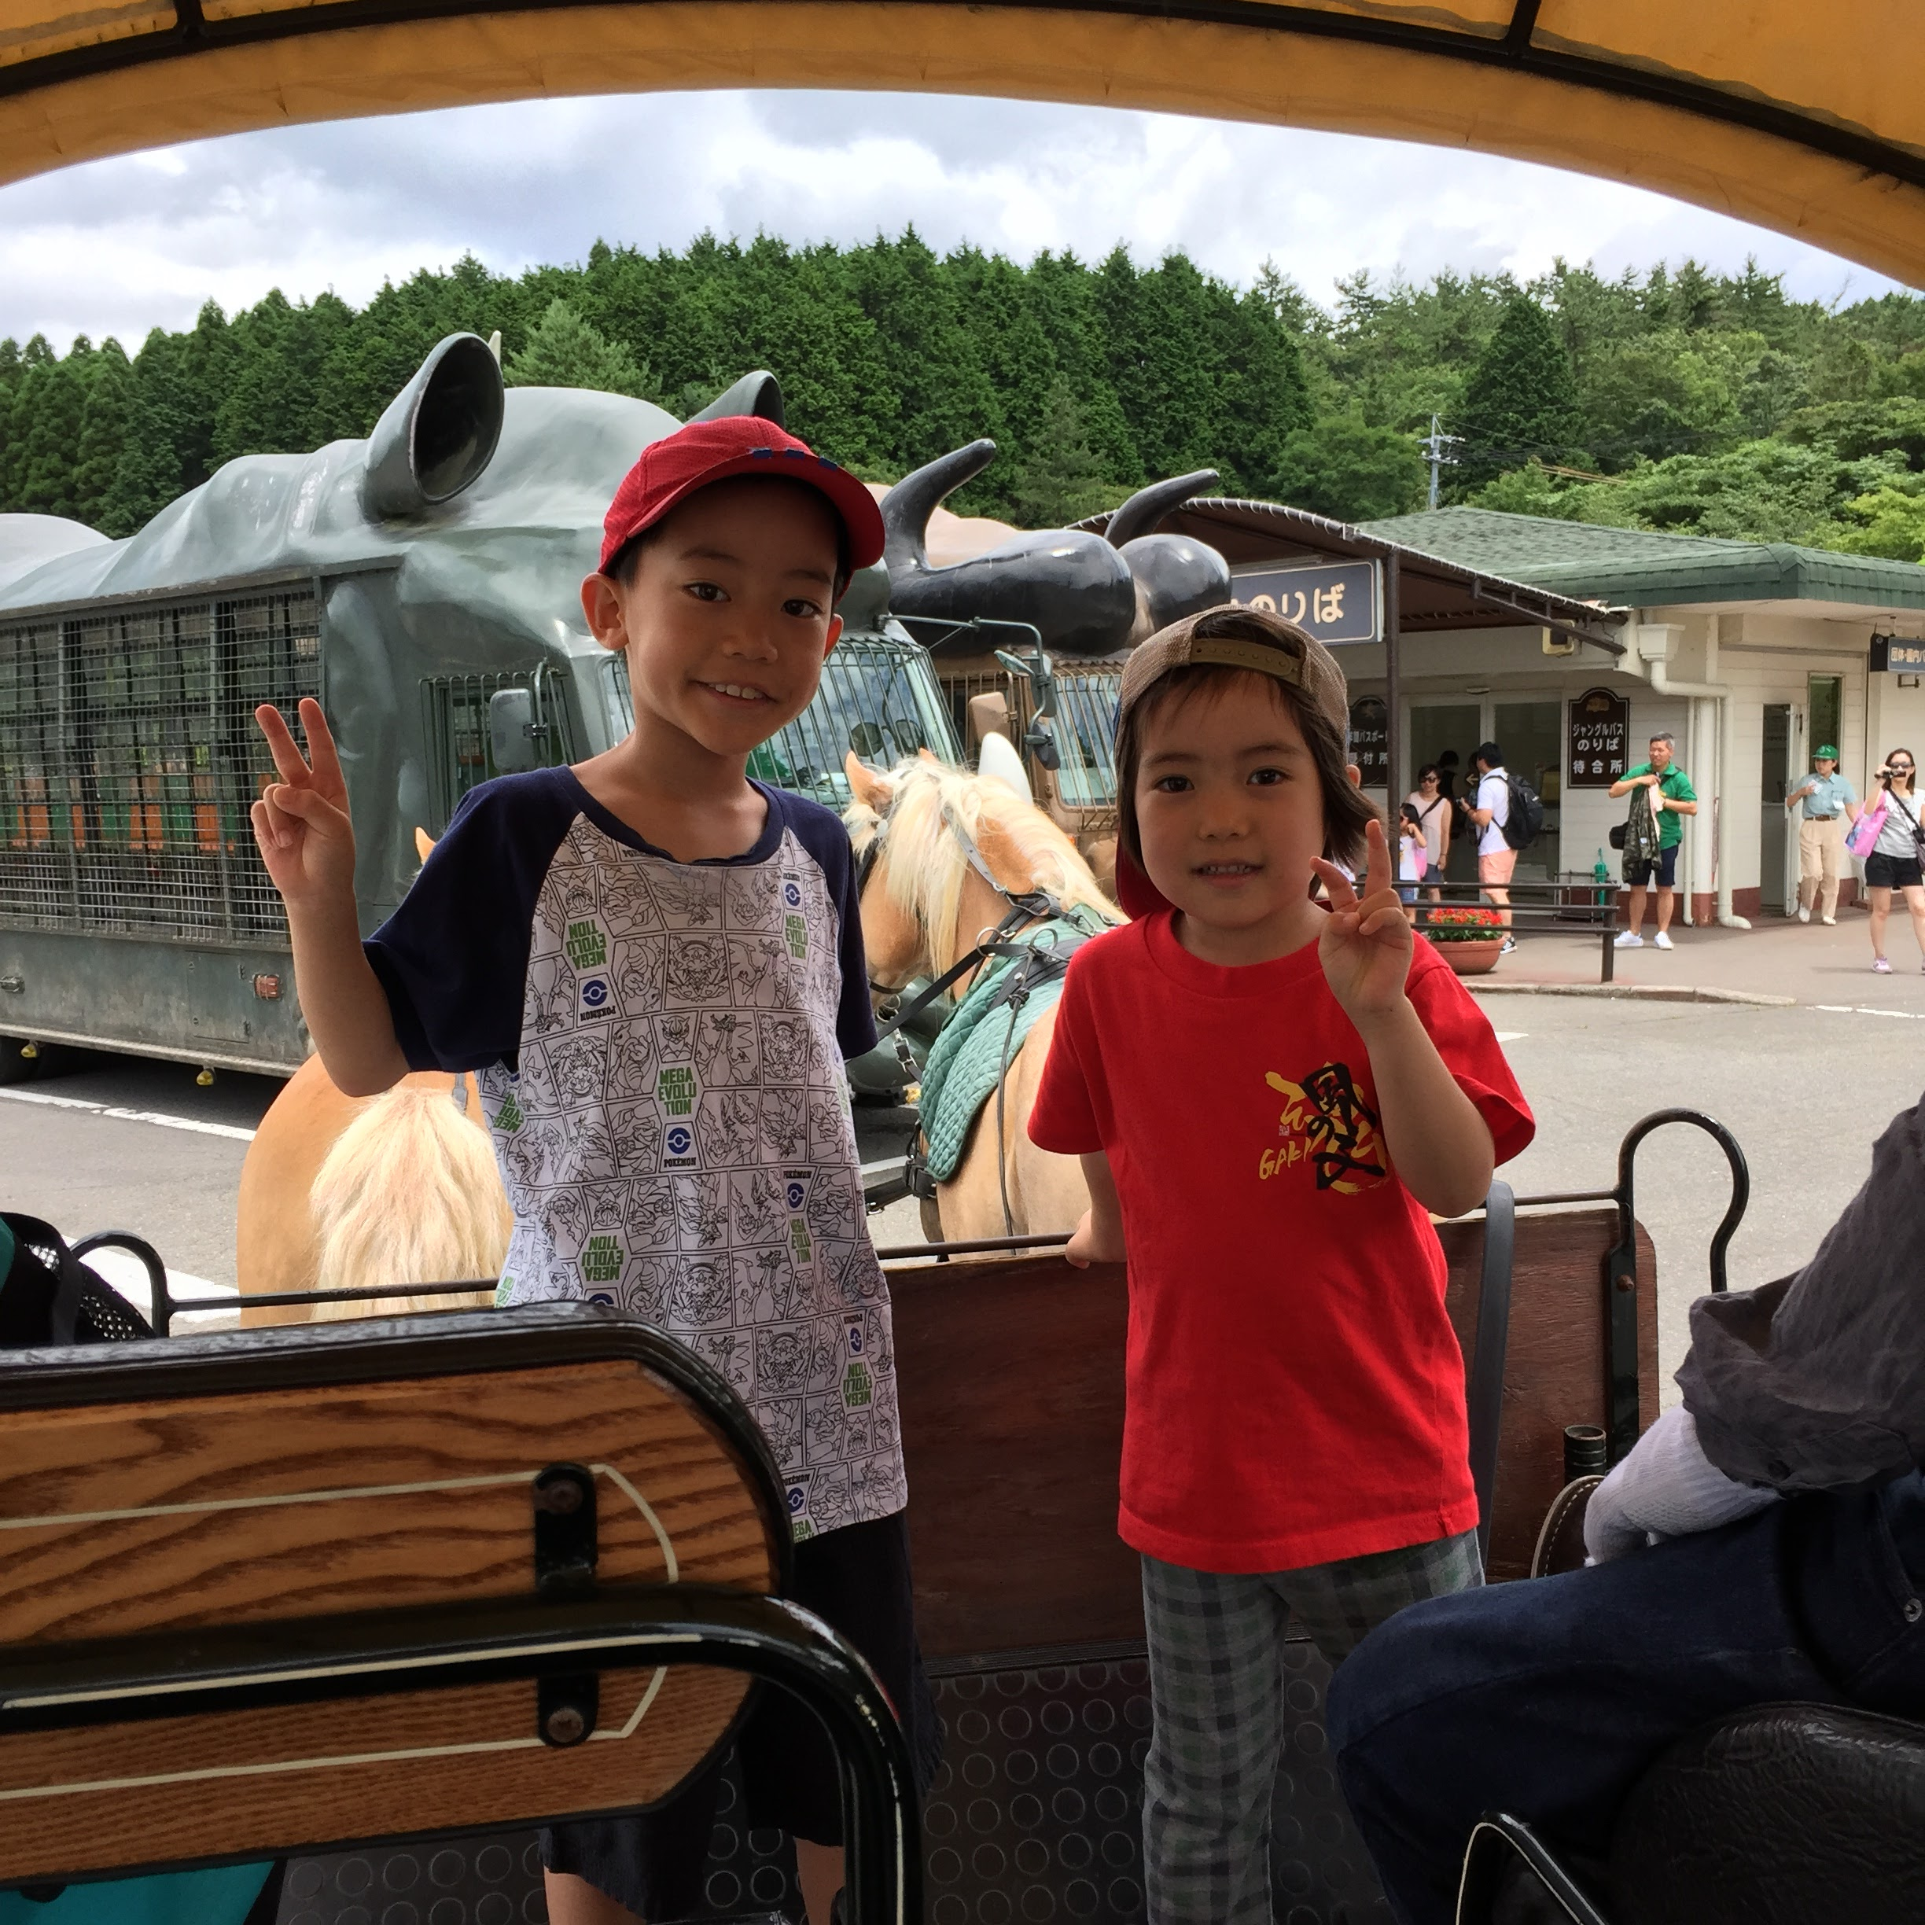
How do I find
this conference?

Slide 4
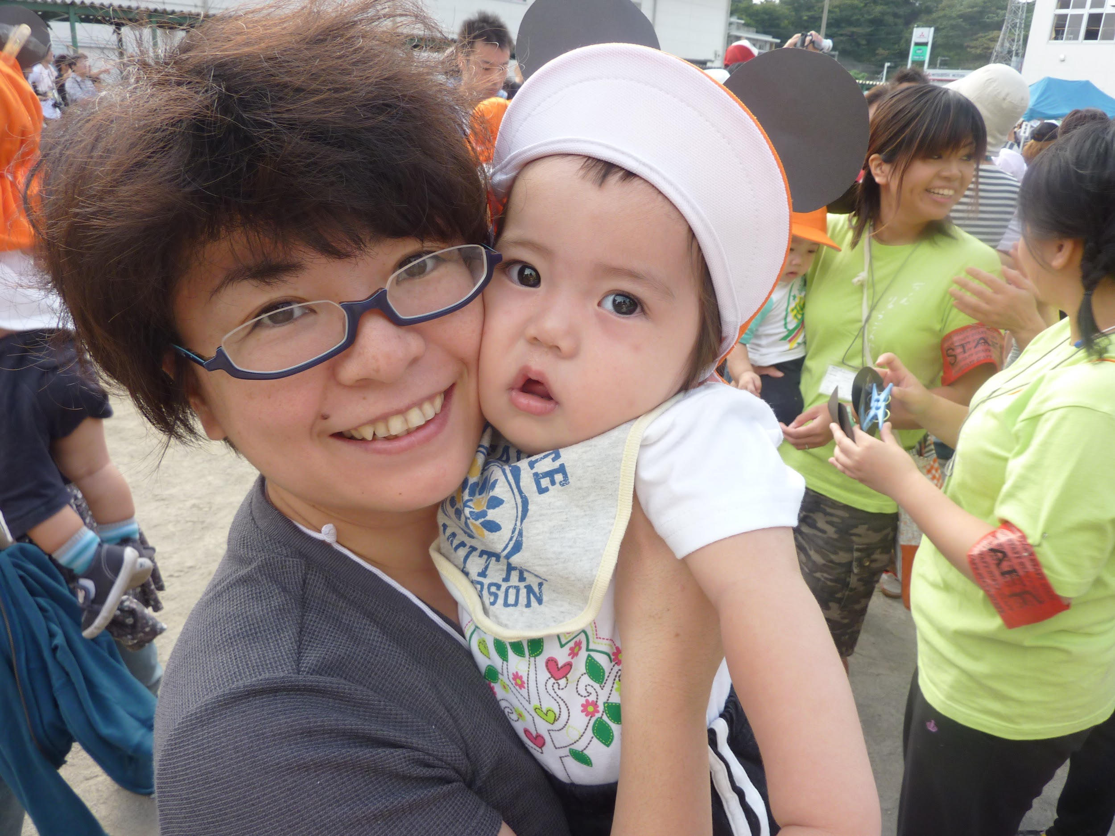
Mr. Yoshioka told me
this conference
on a women lighting speach meeting.

Slide 5
Why do I want to join this conference?

Slide 6
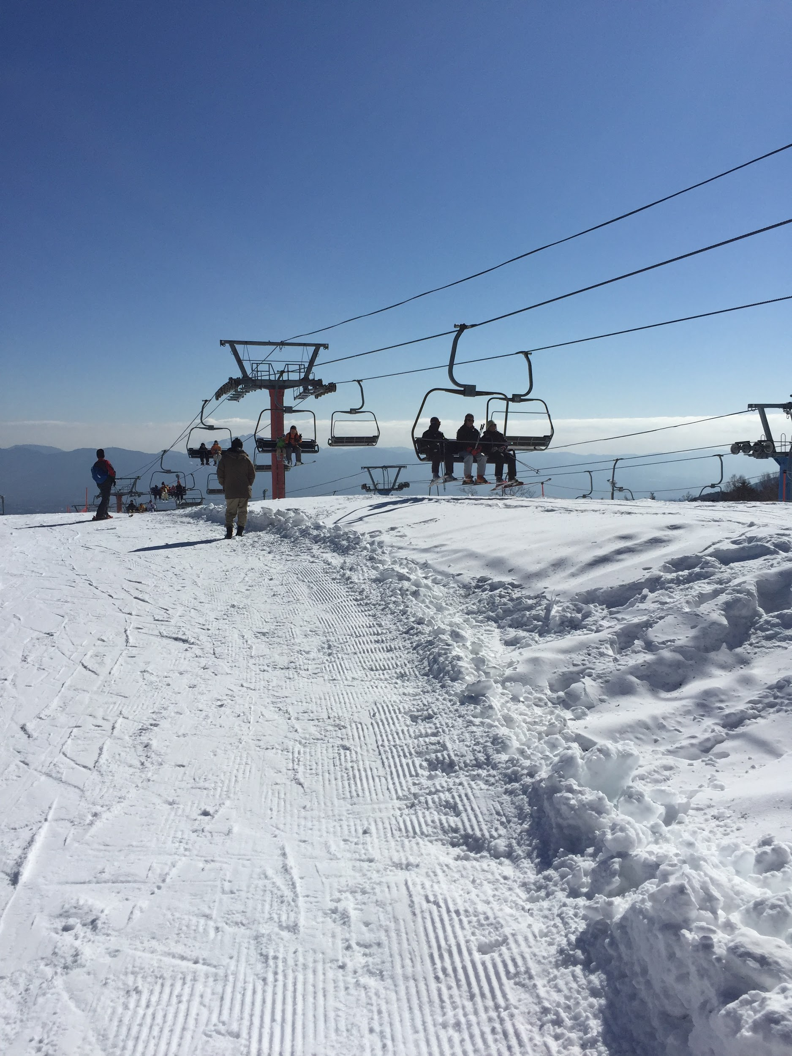
Three years ago, I could not use English well in spite of the fact that I studied it from junior high school.

Slide 7
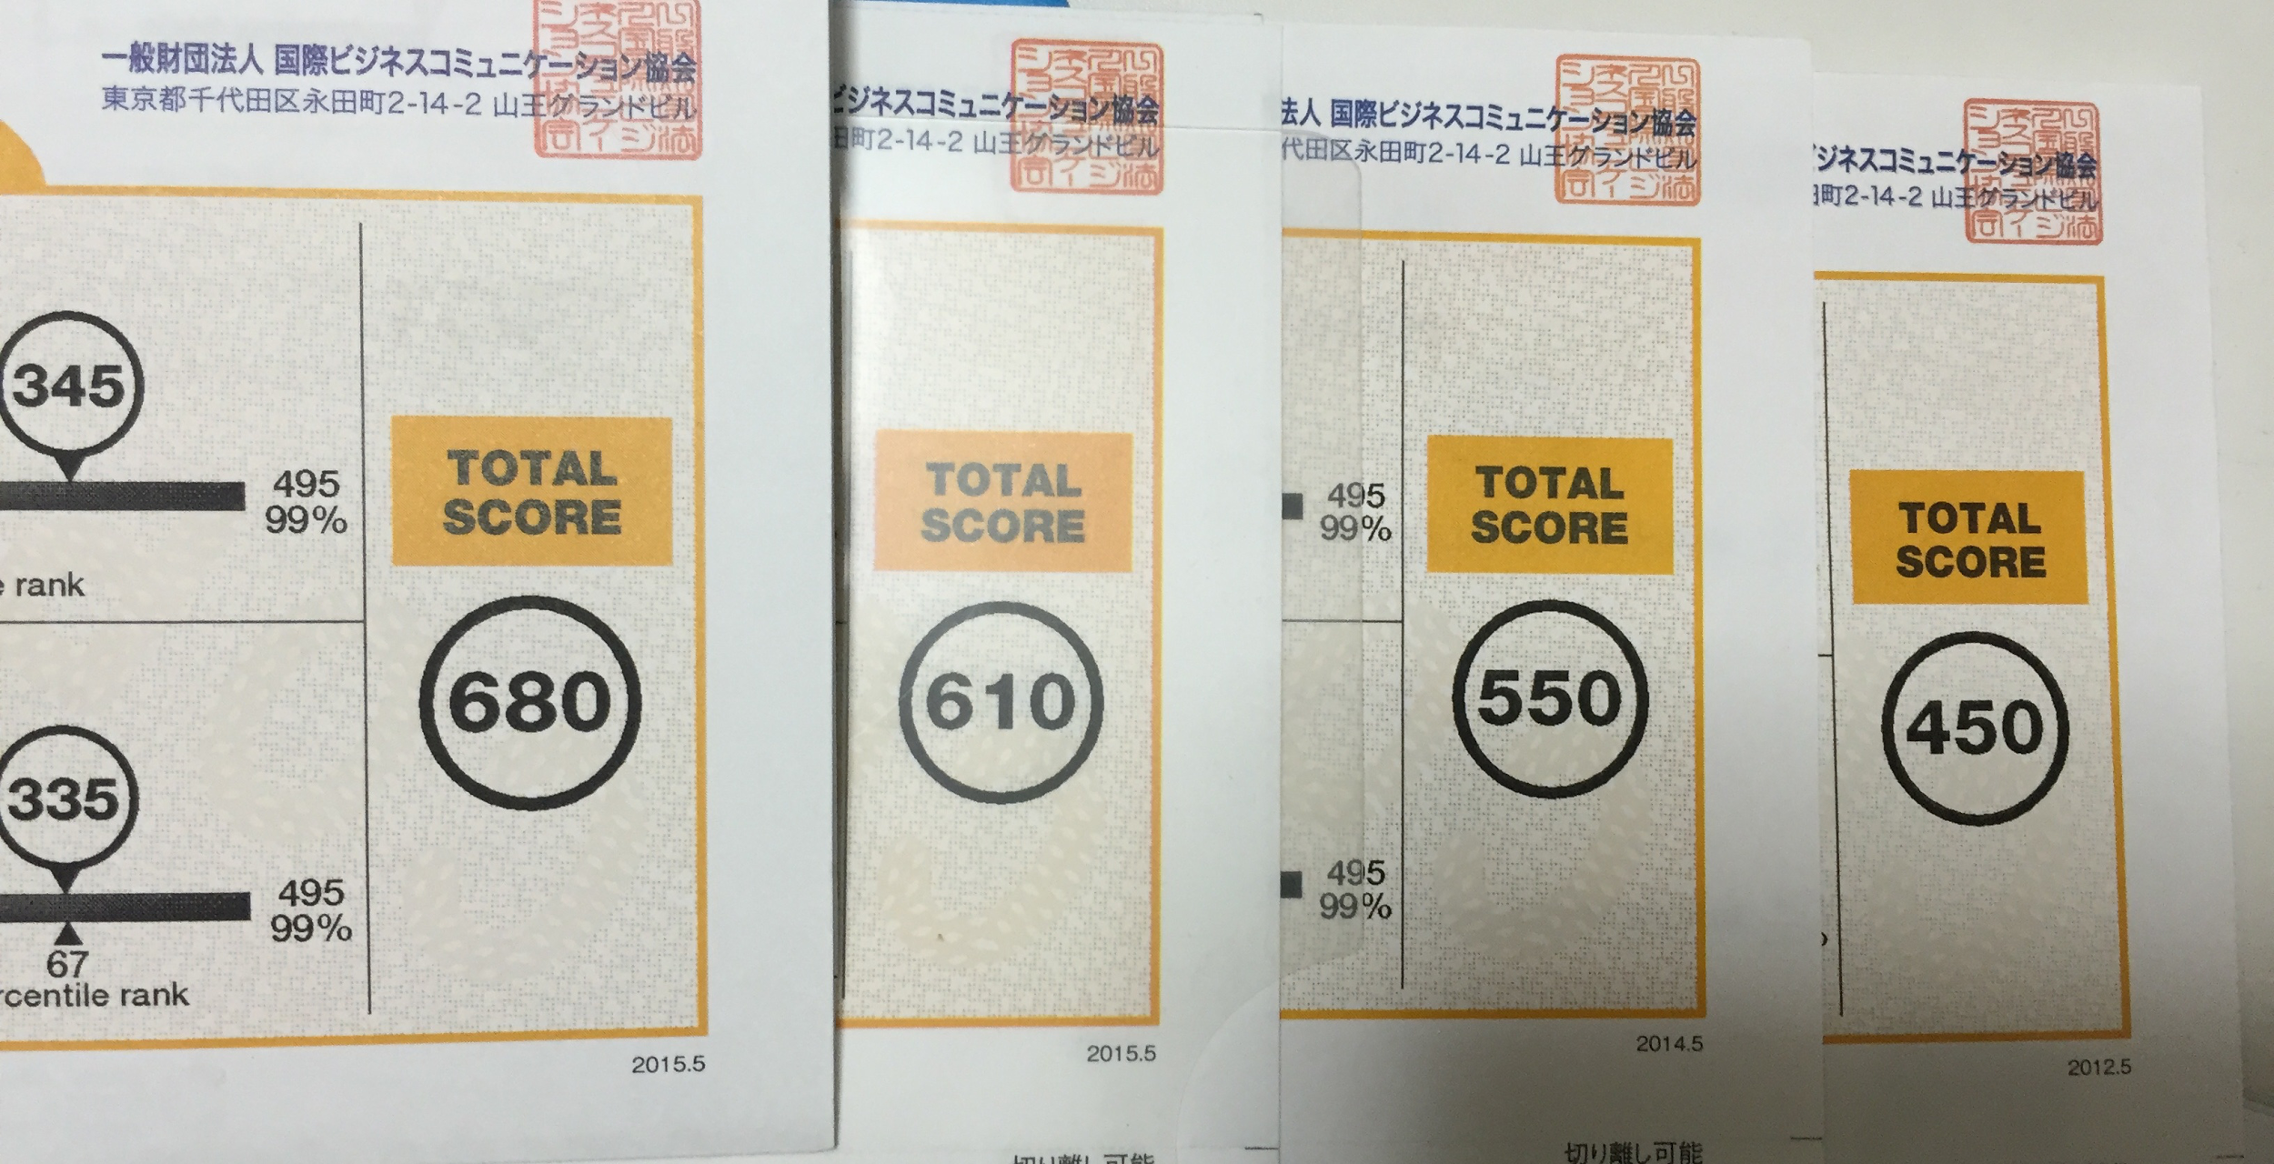
I took TOEIC 13 times for 3 years.
450 -> 680

Slide 8
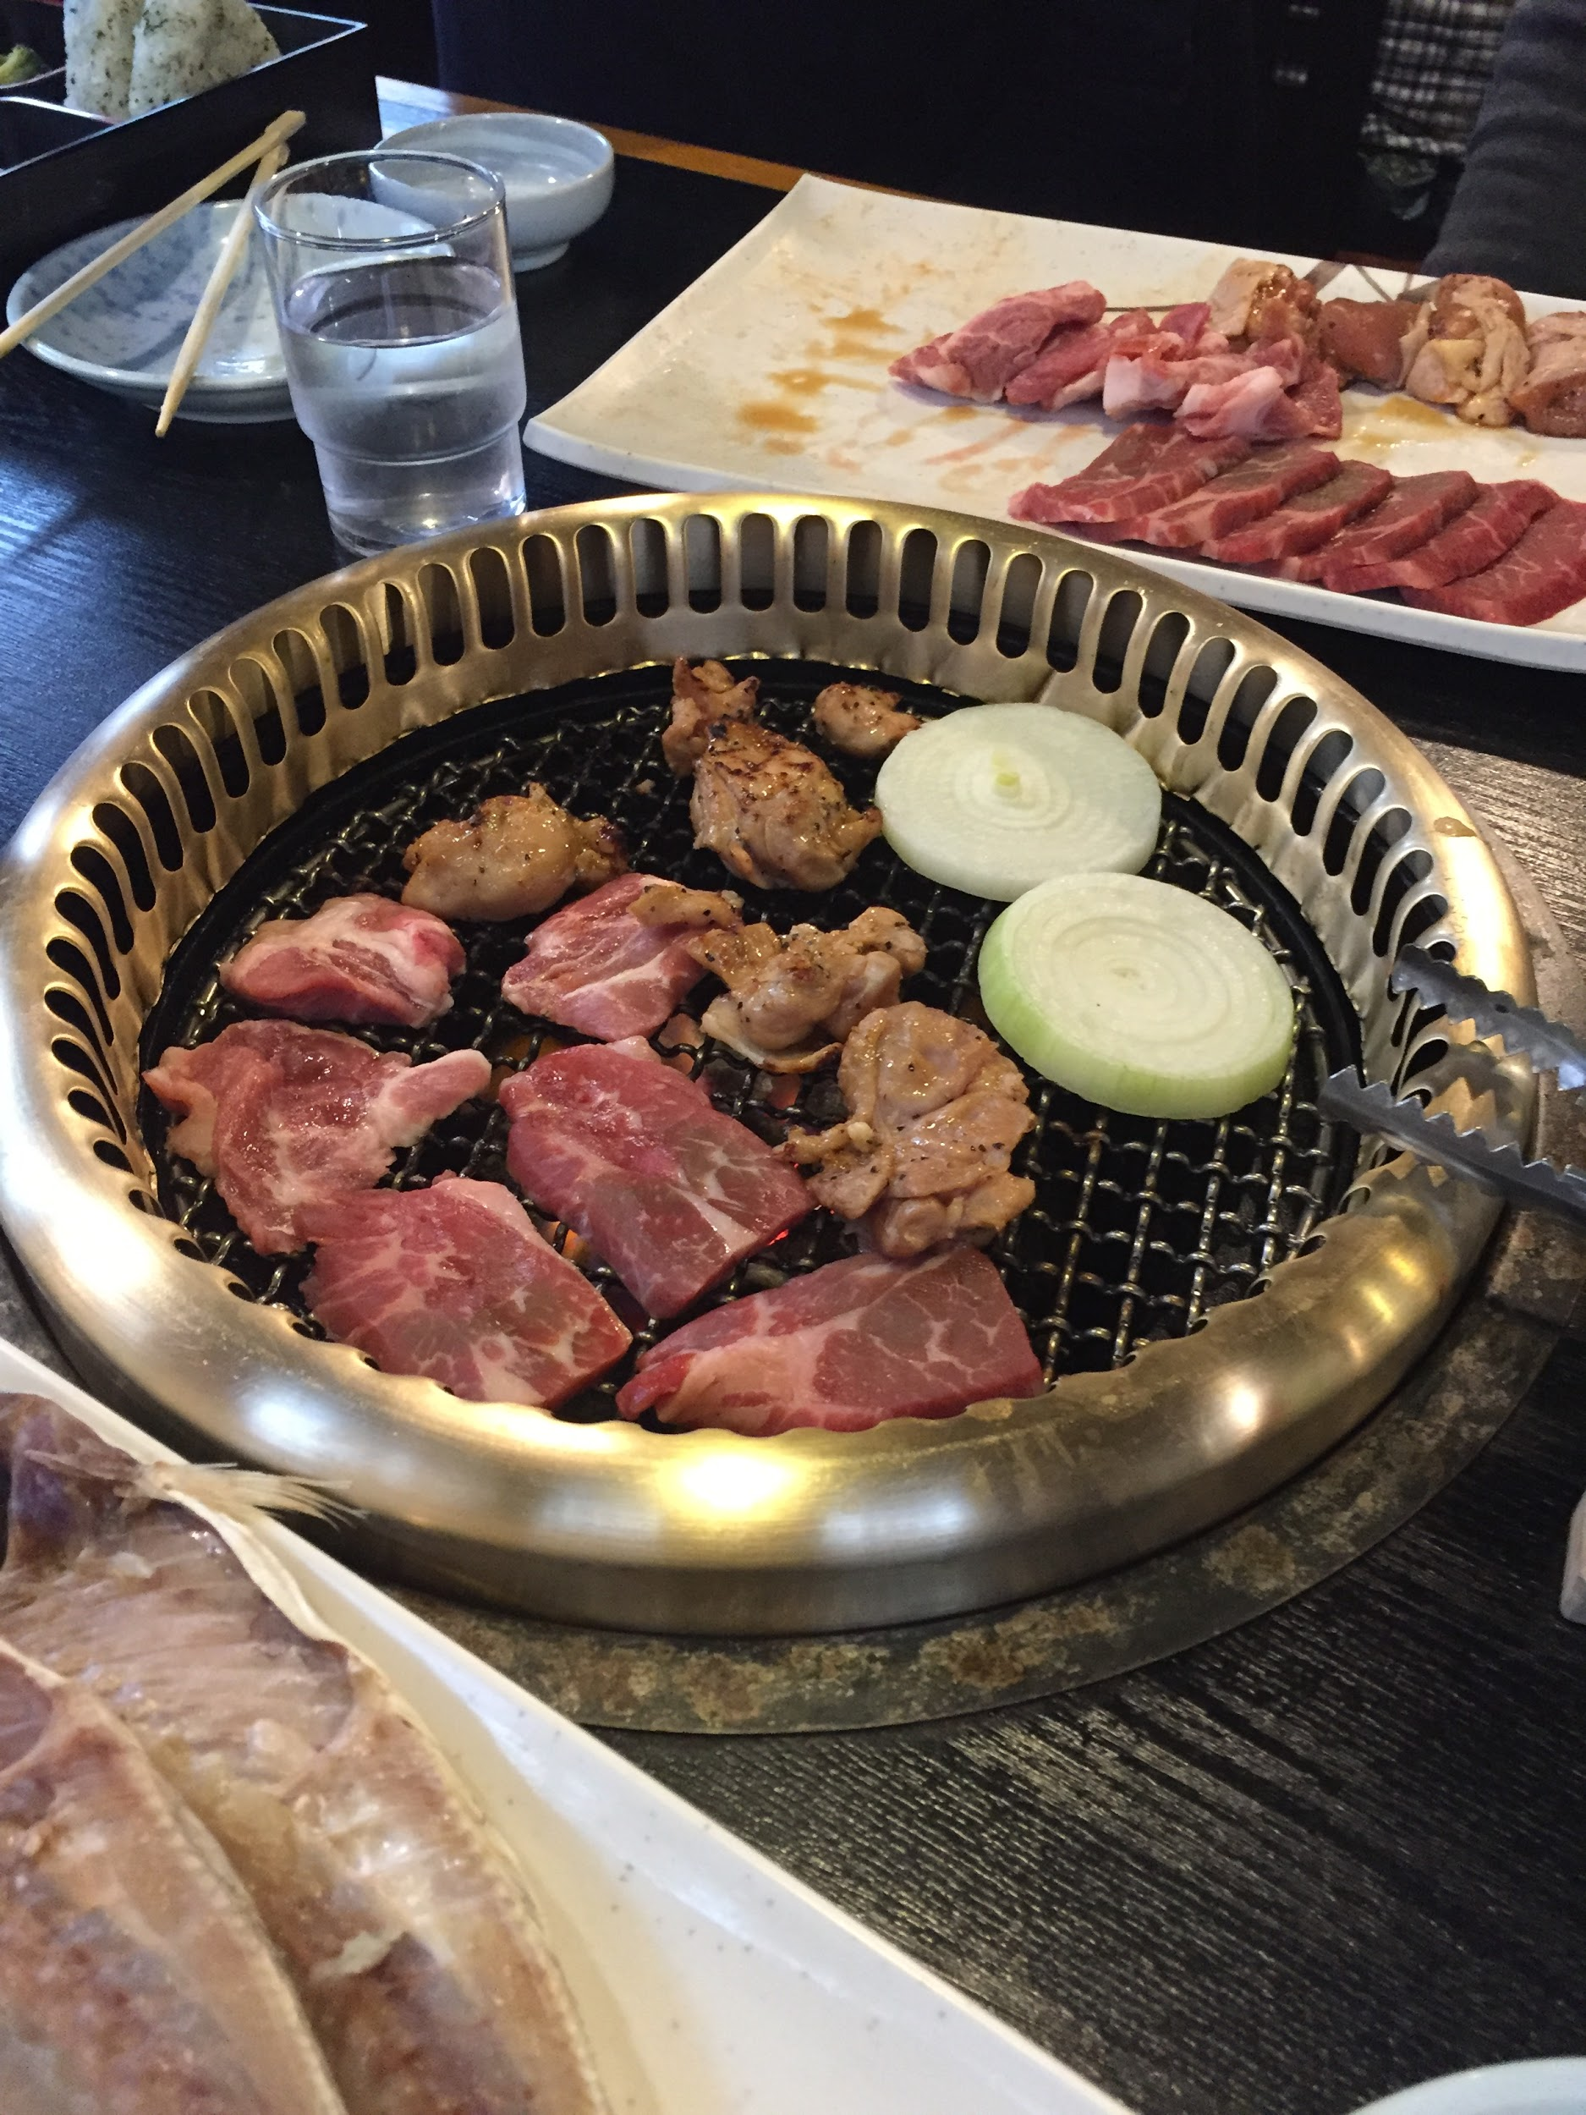
Nowadays, I'm not motivated because I do not have opportunity to use English.

Slide 9
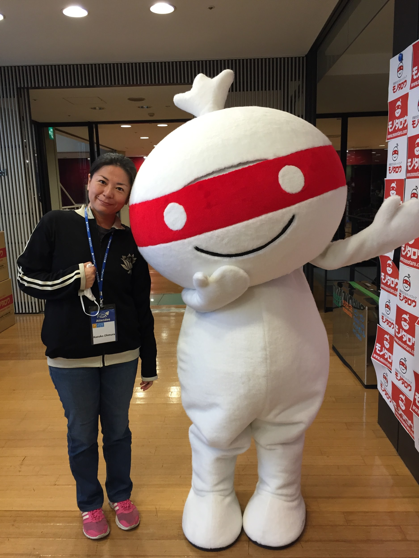
I decide that I will do my best in the future too.
Thank you!

